Slide 1

Jessica Ryan
President, Irish Surgical Training Group 2022-23
www.istg.ie
@ISTGofficial

Slide 2
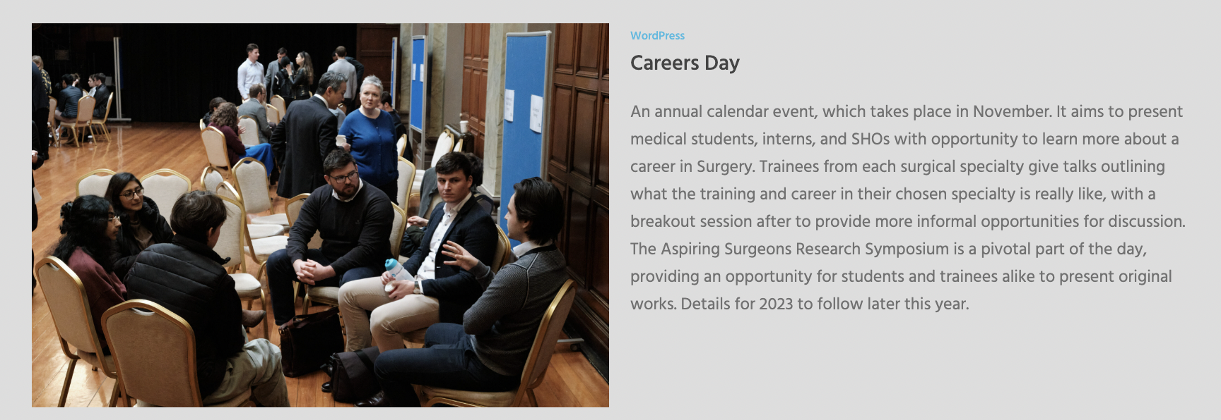
Careers Day

Slide 3

Charter week session

Slide 4
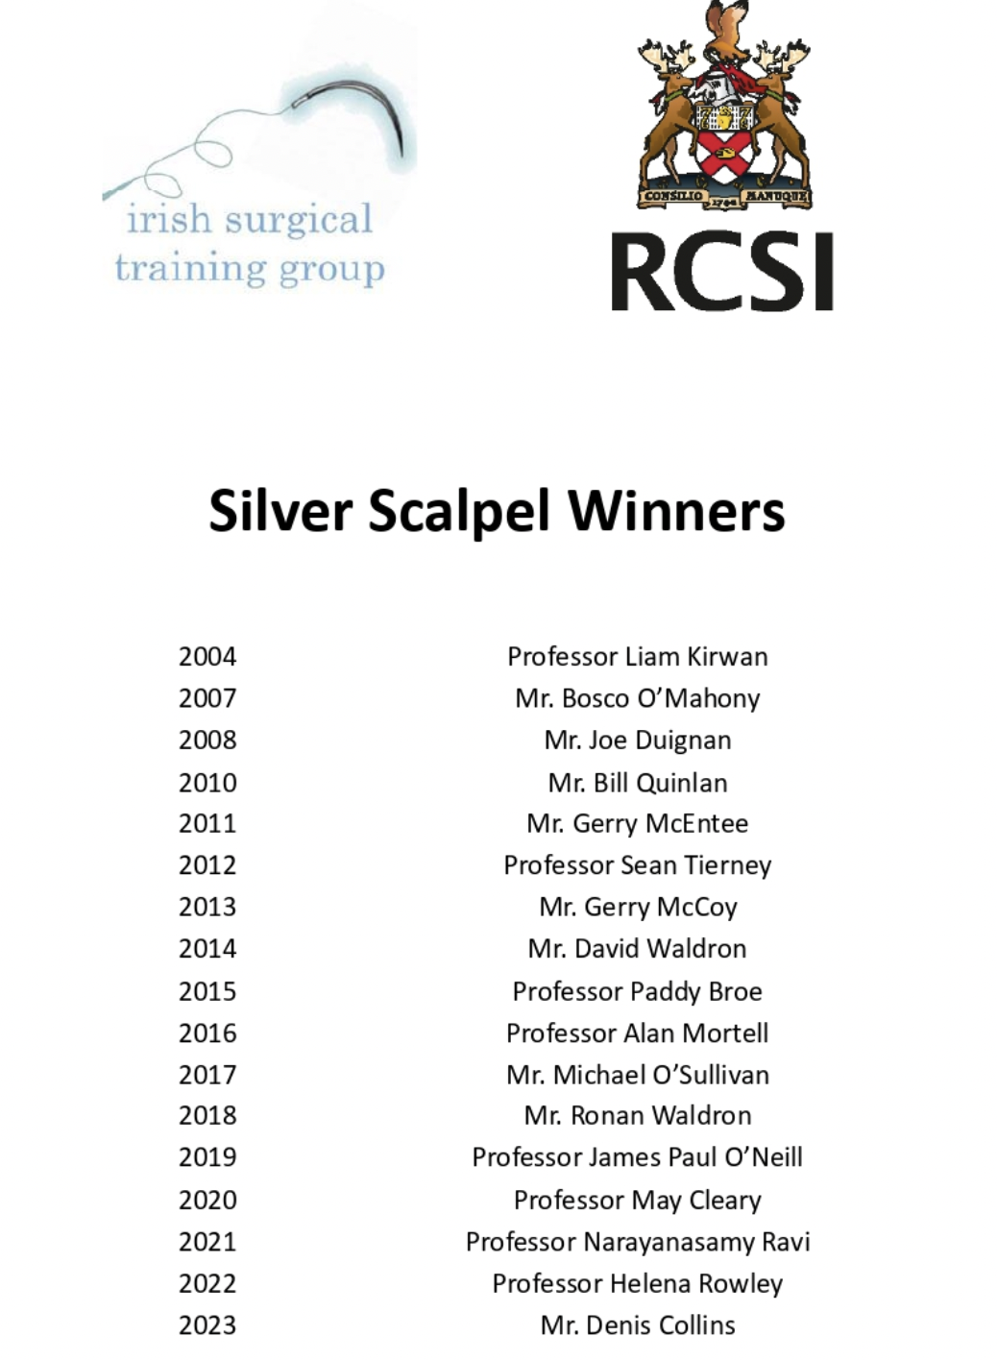
Silver Scalpel Dinner

Slide 5
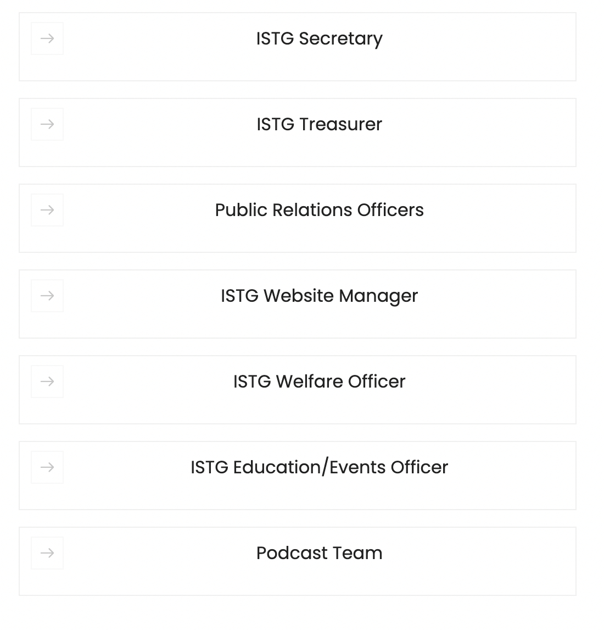
2023-24 committee applications

Slide 6
2023-24 committee applications
https://istg.ie/home/about-us/istg-comittee-roles/
Closing date 30th June 2023
info@istg.ie

Slide 7
Jessica Ryan
President, Irish Surgical Training Group 2022-23
jessicaryan@rcsi.com
www.istg.ie
@ISTGofficial

