Slide 1
Higher Surgical Training ST3 – ST8 30th June 2023

Slide 2
HIGHER SPECIALTY TRAINING (HST) IN SURGERY
Oversight / Governance
Curriculum
Syllabus
Indicative numbers of operative procedures/ logbook
Assessments
Annual Review of Competence Progression (ARCP)
Out Of Programme (OOP)
Research
Examination (Intercollegiate Fellowship examination)
Certificate of Completion of Specialist Training (CCST)
Post-CCST Fellowship
Courses

Slide 3
GOVERNANCE OF SURGICAL TRAINING
MEDICAL COUNCIL
HSE NDTP
RCSI

Slide 4
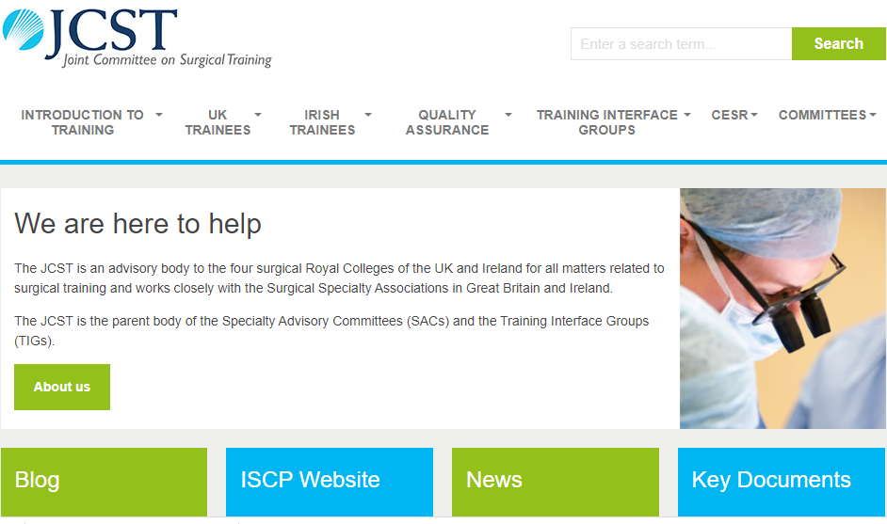

Slide 5
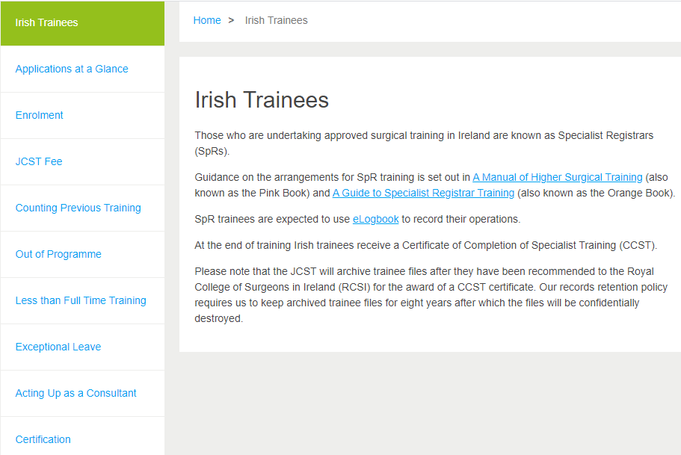

Slide 6
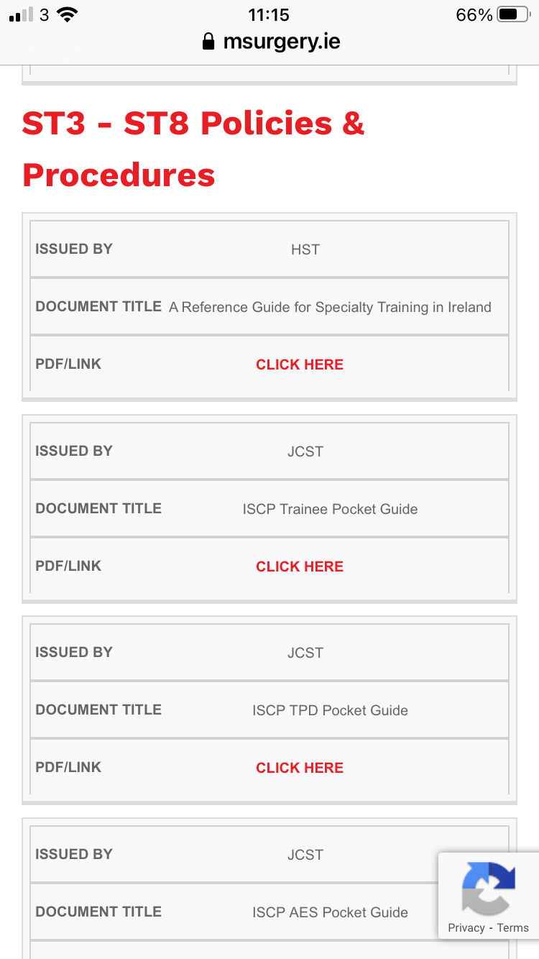
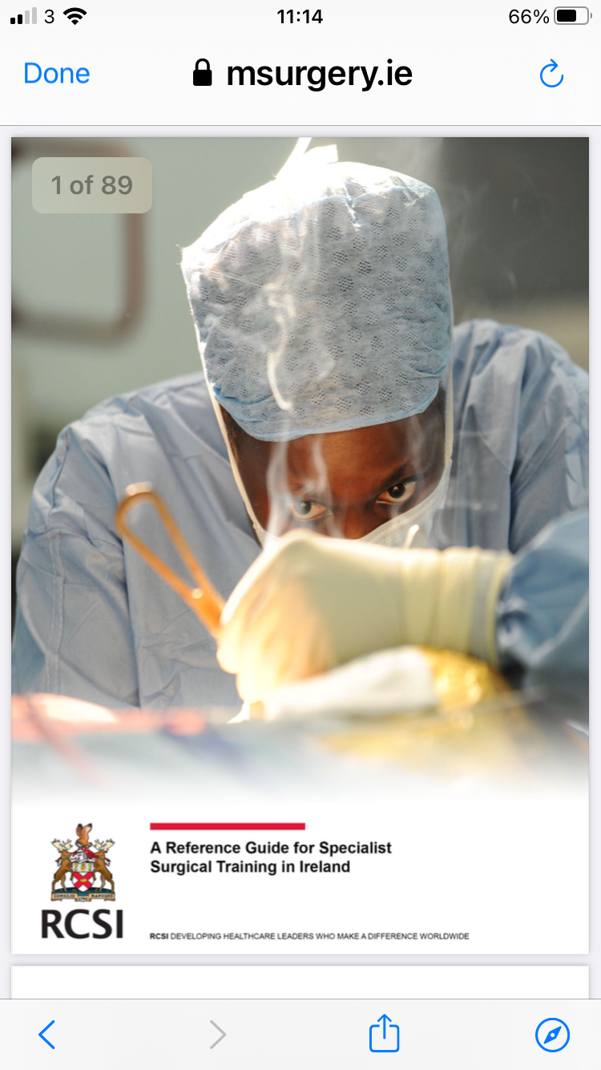

Slide 7
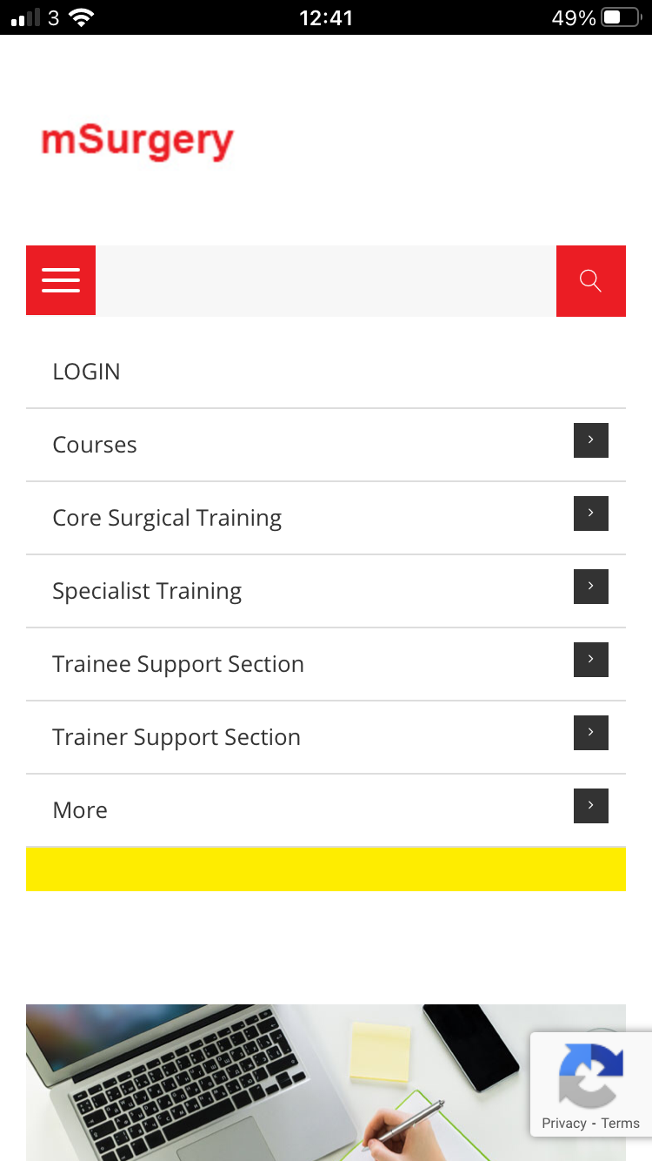
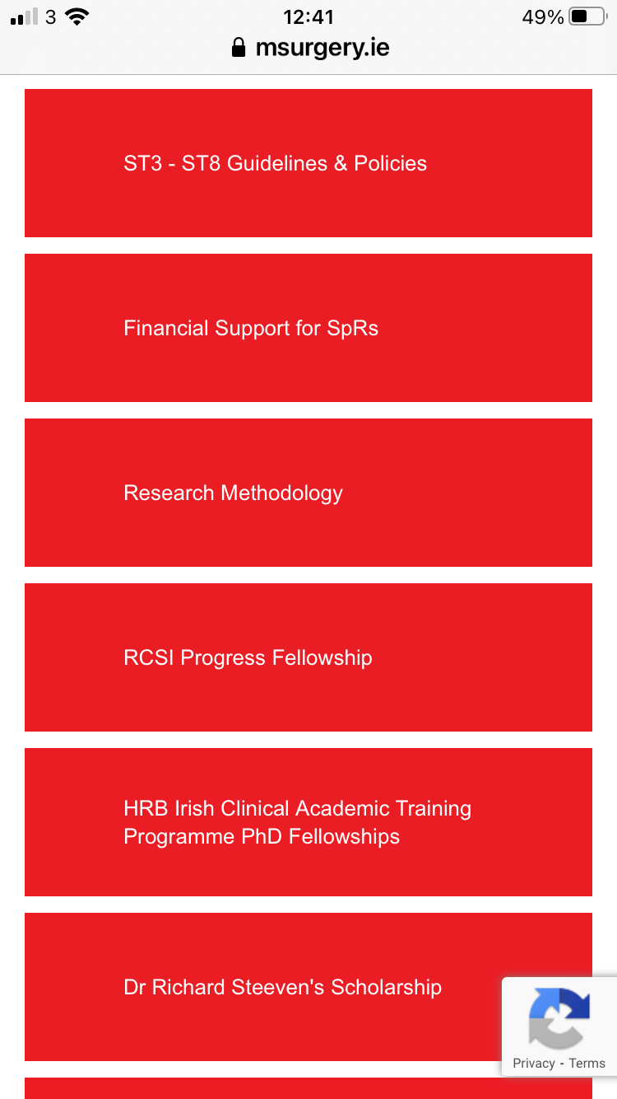
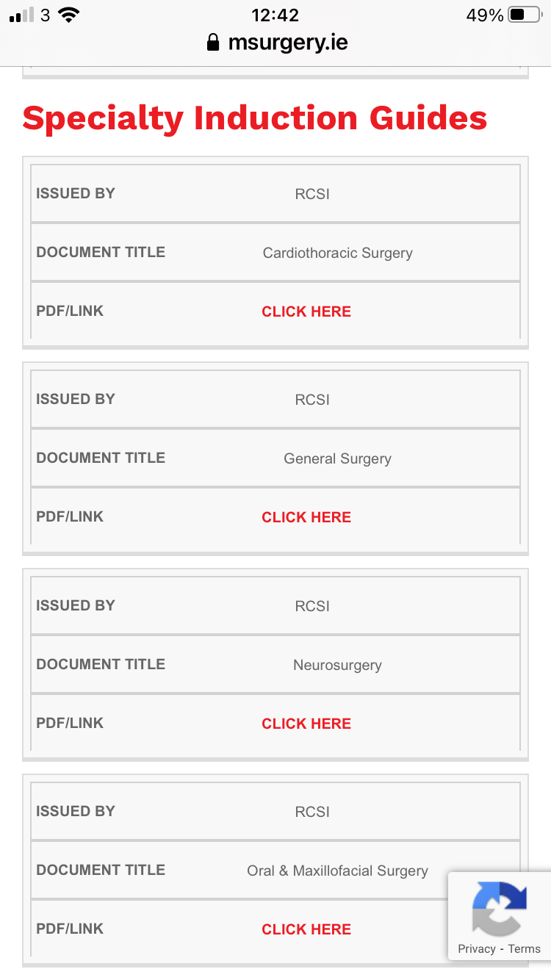
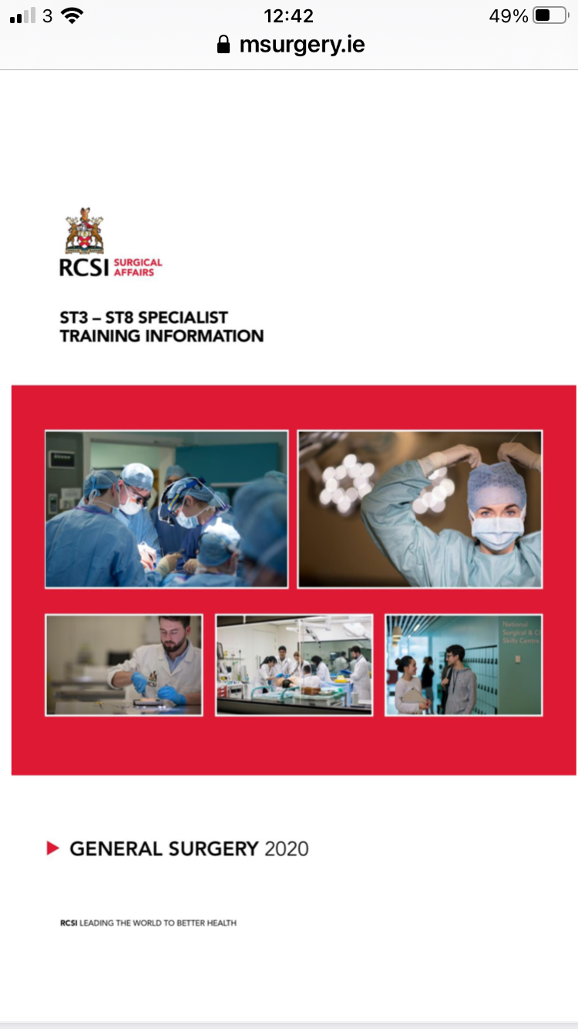

Slide 8
INTERCOLLEGIATE SURGICAL CURRICULUM PROGRAMME

Slide 9
INTERCOLLEGIATE SURGICAL CURRICULUM PROGRAMME
What is a curriculum?
Structure of training
Outcome of training
What will be learned (syllabus)
How it will be taught (pedagogy)
How it will be assessed (assessment framework)
Roles/responsibilities of trainers

Slide 10
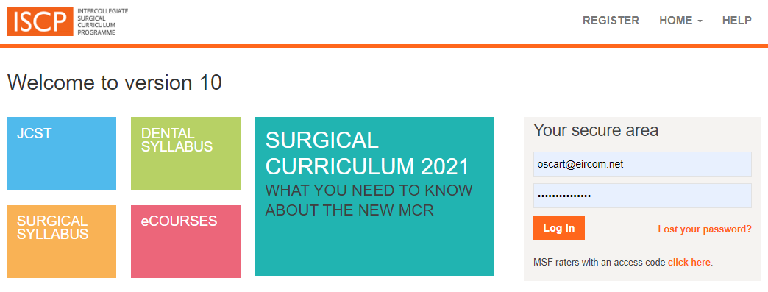
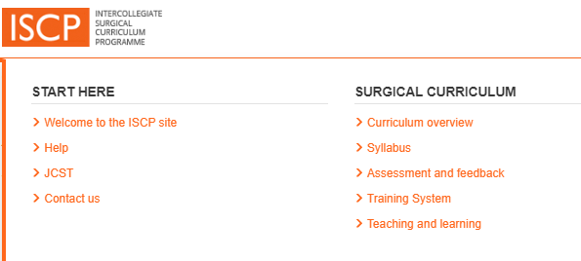
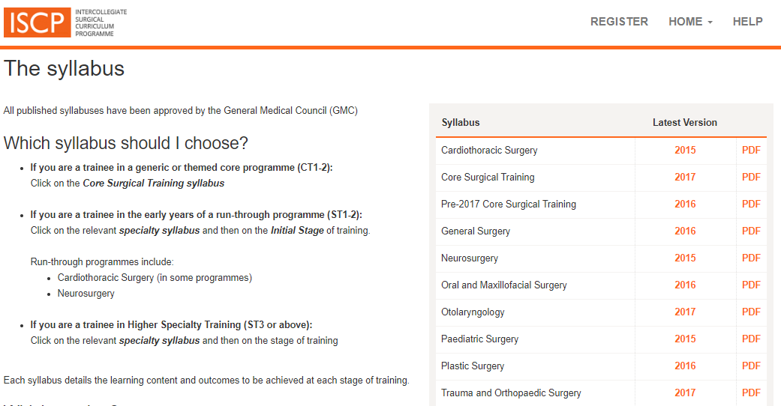
Syllabus
Training process/milestones
Trainer roles
Assessment framework
Verification of competence

Slide 11
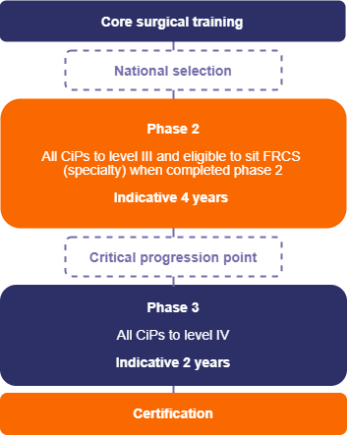
The training pathway

Slide 12
HIGHER SPECIALTY TRAINING (HST) IN SURGERY
Oversight
Curriculum
Syllabus
Indicative numbers of operative procedures/ logbook
Assessments
Annual Review of Competence Progression (ARCP)
Out Of Programme (OOP)
Research
Examination (Intercollegiate Fellowship examination)
Certificate of Completion of Specialist Training (CCST)
Post-CCST Fellowship
Courses

Slide 13
HIGHER SPECIALTY TRAINING (HST) IN SURGERY
Oversight
Curriculum
Syllabus
Indicative numbers of operative procedures/ logbook
Assessments
Annual Review of Competence Progression (ARCP)
Out Of Programme (OOP)
Research
Examination (Intercollegiate Fellowship examination)
Certificate of Completion of Specialist Training (CCST)
Post-CCST Fellowship
Courses

Slide 14
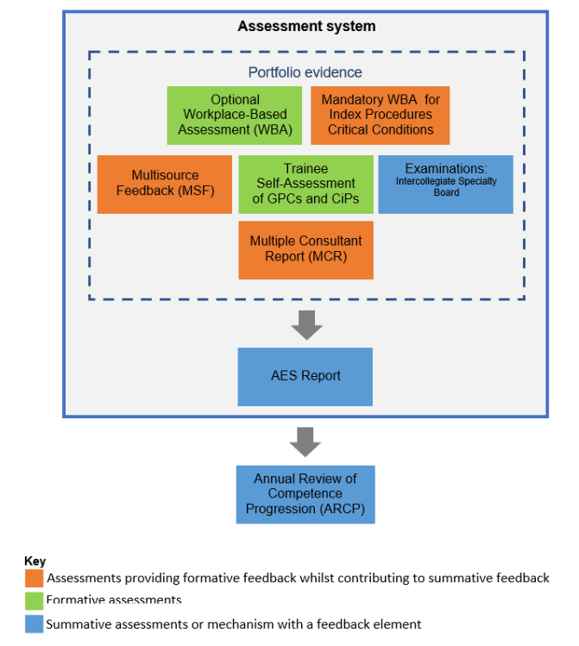
Assessment System

Slide 15
The MCR in a placement
Objective setting Learning Agreement
Mid-point
Learning Agreement
Final Review
Learning Agreement
Last MCR reviewed
at start of placement
First half of placement
Second half of placement
Workplace Based Assessments
Interim MCR
End of placement MCR

Slide 16
HIGHER SPECIALTY TRAINING (HST) IN SURGERY
Oversight
Curriculum
Syllabus
Indicative numbers of operative procedures/ logbook
Assessments
Annual Review of Competence Progression (ARCP)
Out Of Programme (OOP)
Research
Examination (Intercollegiate Fellowship examination)
Certificate of Completion of Specialist Training (CCST)
Post-CCST Fellowship
Courses

Slide 17
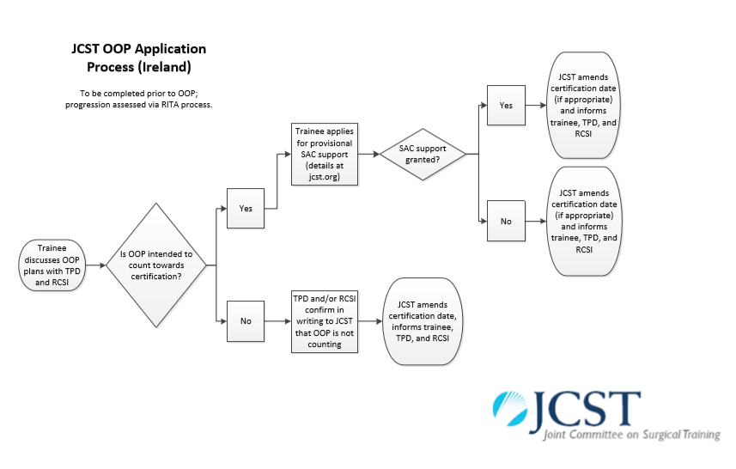
Training
Research
Experience

Slide 18
HIGHER SPECIALTY TRAINING (HST) IN SURGERY
Oversight
Curriculum
Syllabus
Indicative numbers of operative procedures/ logbook
Assessments
Annual Review of Competence Progression (ARCP)
Out Of Programme (OOP)
Research: Research Methodology course/ Time out for fulltime research
Examination (Intercollegiate Fellowship examination)
Certificate of Completion of Specialist Training (CCST)
Post-CCST Fellowship
Courses

Slide 19
HIGHER SPECIALTY TRAINING (HST) IN SURGERY
Oversight
Curriculum
Syllabus
Indicative numbers of operative procedures/ logbook
Assessments
Annual Review of Competence Progression (ARCP)
Out Of Programme (OOP)
Research: Research Methodology course/ Time out for fulltime research
Examination (Intercollegiate Fellowship examination)
Certificate of Completion of Specialist Training (CCST)
Post-CCST Fellowship
Courses

Slide 20
HIGHER SPECIALTY TRAINING (HST) IN SURGERY
Oversight
Curriculum
Syllabus
Indicative numbers of operative procedures/ logbook
Assessments
Annual Review of Competence Progression (ARCP)
Out Of Programme (OOP)
Research: Research Methodology course/ Time out for fulltime research
Examination (Intercollegiate Fellowship examination)
Certificate of Completion of Specialist Training (CCST)
Post-CCST Fellowship
Courses

Slide 21
HIGHER SPECIALTY TRAINING (HST) IN SURGERY
Oversight
Curriculum
Syllabus
Indicative numbers of operative procedures/ logbook
Assessments
Annual Review of Competence Progression (ARCP)
Out Of Programme (OOP)
Research: Research Methodology course/ Time out for fulltime research
Examination (Intercollegiate Fellowship examination)
Certificate of Completion of Specialist Training (CCST)
Post-CCST Fellowship
Courses: MCh (full-time/part-time) / MSc Human Factors in Patient Safety/ Online Professionalism

Slide 22
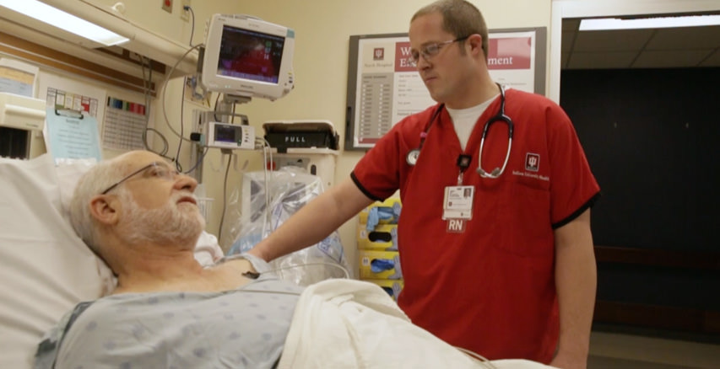
SURGERY IS STRESSFUL

Slide 23
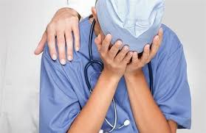
Surgery is Stressful
TALK to SOMEONE!

Slide 24
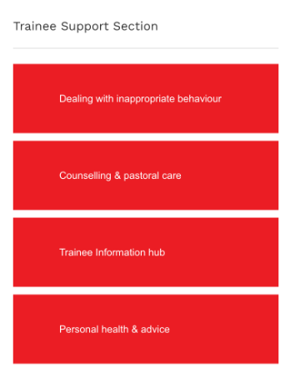
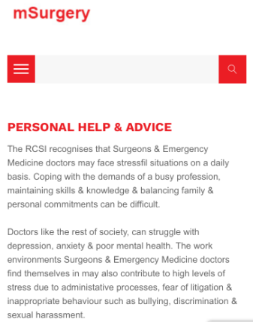

Slide 25
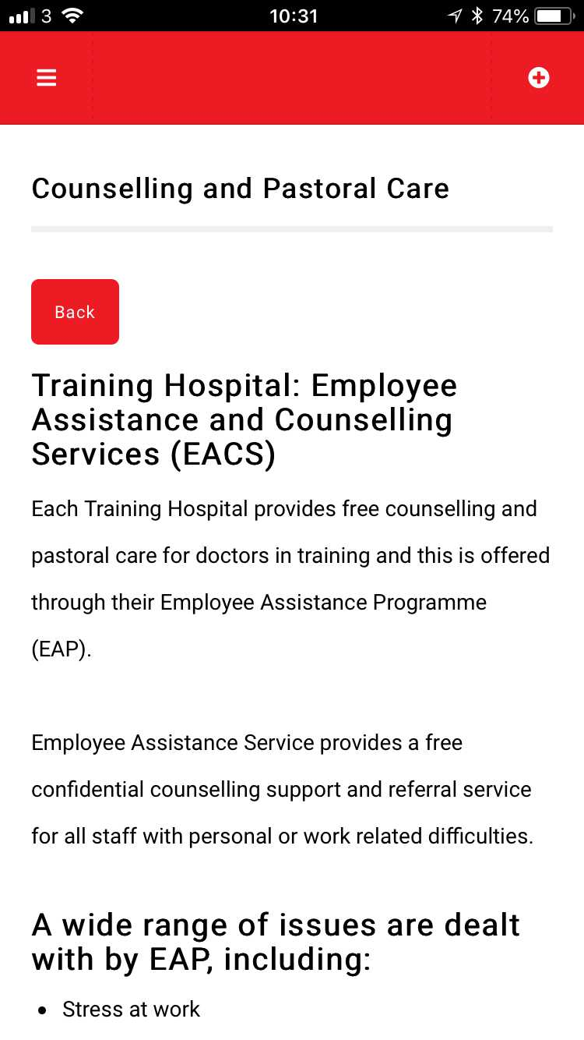
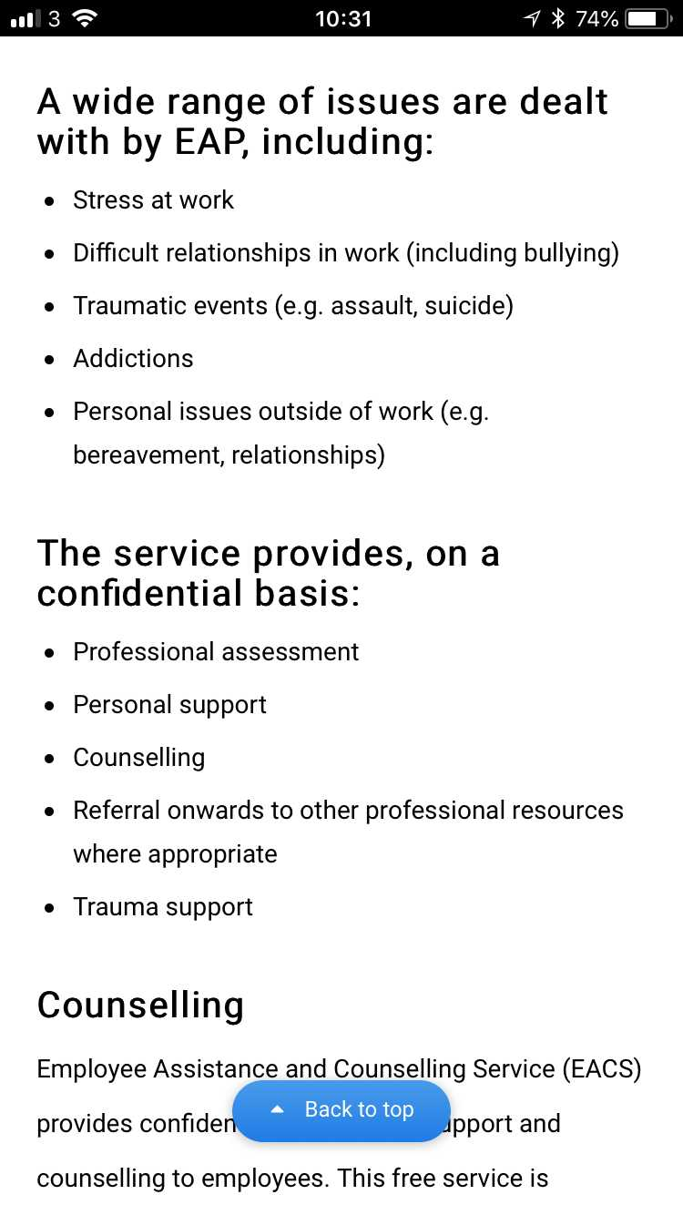

Slide 26
Thank you

